Slide 1

Where Should We Build Brooklyn's Next Donut Shop?
Data Science Certificate Capstone Project

Slide 2

THE PROBLEM
A national doughnut chain wants to expand their business by opening a new doughnut shop in Brooklyn, NY, but which neighborhood should they choose?
They would like a shop in a great location to draw a large customer base with large incomes.

Slide 3
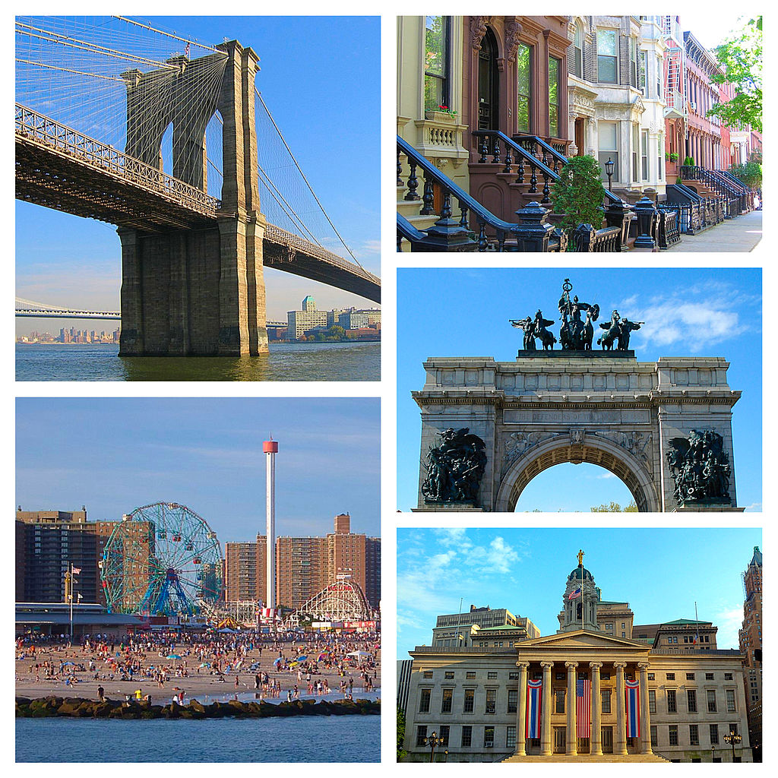
BROOKLYN, NY
Number of Neighborhoods: 70
Population: 2.6 million
Median Income: $56,015
Number of Commercial Bakeries Selling Doughnuts: 59
Population per Doughnut Shop: 44,663
Average Revenue per Doughnut Shop:
$2.3 million

Slide 4
THE DATA
2014 New York City Neighborhood Names Points File
This geospatial data was used to locate Brooklyn and all of its neighborhoods for mapping purposes.
Foursquare API
This data was used to determine the most common venue in each neighborhood. The most common venues were used to determine which neighborhoods do not have doughnut shops, which will guide the national doughnut chain to the neighborhood ripest for development.
US Census Demographic & Business Data
Provided background information on Brooklyn and its neighborhoods to help select the right location.

Slide 5
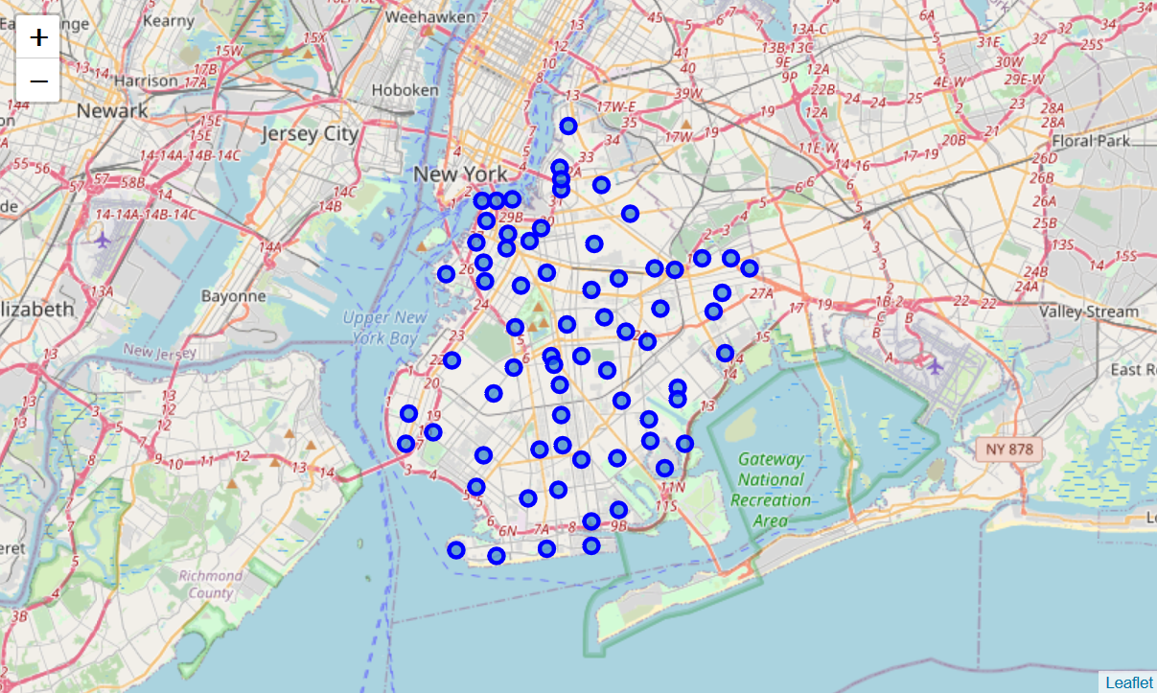
METHODOLOGY
Brooklyn’s 70 neighborhoods were mapped using Folium and the NY geospatial data.

Slide 6
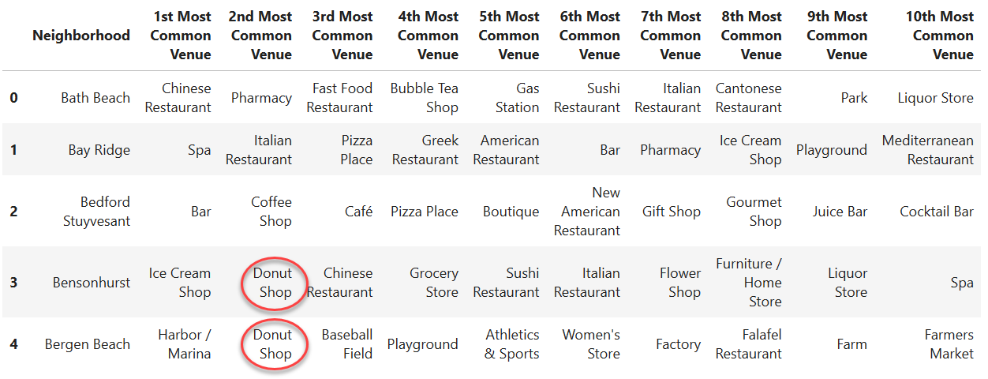
METHODOLOGY (cont.)
Using Foursquare, the top 10 most common venues were determined for each neighborhood.

Slide 7
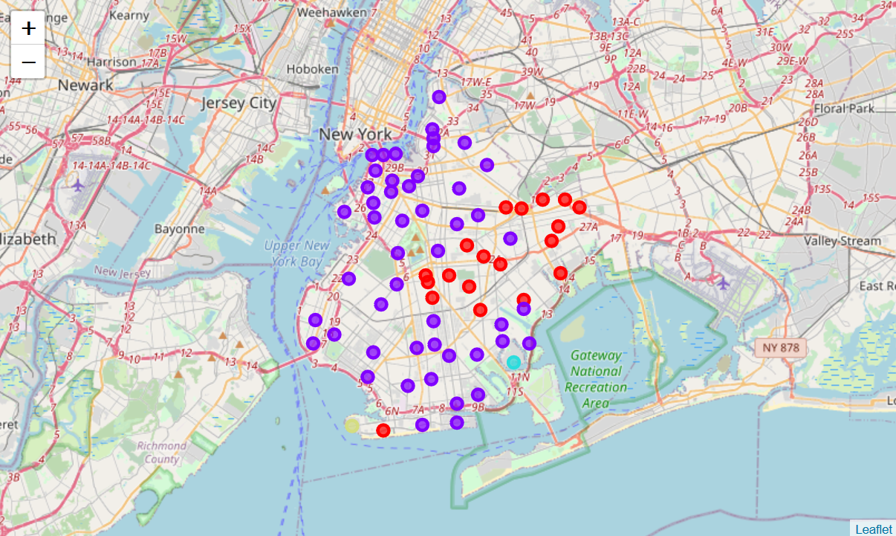
METHODOLOGY (cont.)
The neighborhoods were clustered using the k-means algorithm to group similar neighborhoods together. Four clusters were produced.

Slide 8
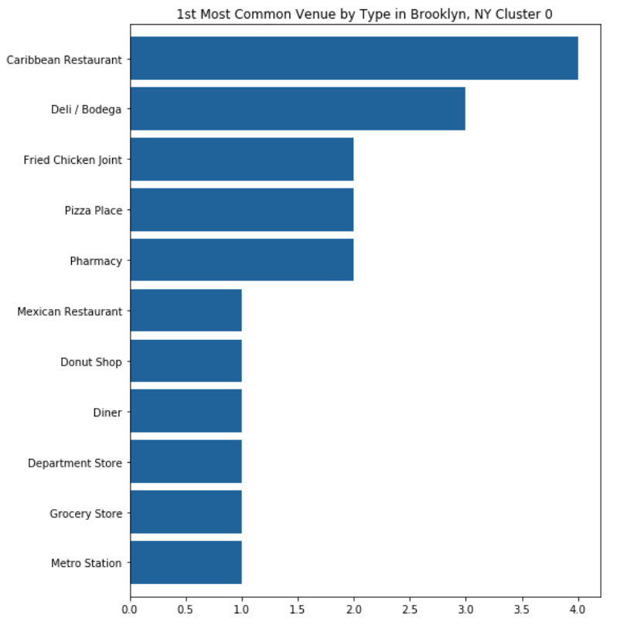
RESULTS
Cluster 0 has 19 neighborhoods. This set of first most common venues are varied, where Caribbean restaurants are most common in four of the neighborhoods. A doughnut shop is the first most common venue for just one neighborhood.

Slide 9
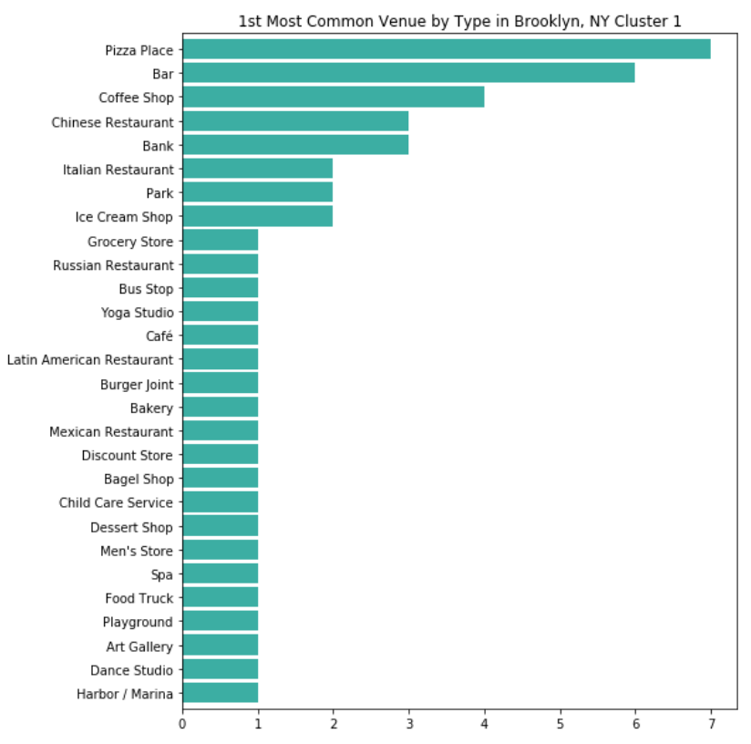
RESULTS (cont.)
Cluster 1 has an even more diverse set of first common venues than Cluster 0.It’s important to note that doughnut shops were not first most common for any of the neighborhoods, which may be good news for the national doughnut chain looking for the perfect location.

Slide 10
RESULTS (cont.)
Clusters 2 and 3 each only had one neighborhood.
To find areas where a new doughnut shop would be welcomed, the data was then subset to include only those neighborhoods without a doughnut shop.
The neighborhoods were then sorted by the number of venues and ranked. The top 20 neighborhoods were considered the short list of possible locations for the new doughnut shop.

Slide 11
DISCUSSION
A national doughnut chain would like to open in a neighborhood with an active set of venues that already attracts customers.
The top four neighborhoods with the most venues were Brooklyn Heights, Carroll Gardens, South Side, and North Side. Each have at least 100 venues and are located in Cluster 1.
Demographic data was used to select the right neighborhood:
Neighborhood | Population | Median Income | Bachelor Degree or Higher
Brooklyn Heights | 62,823 | $124,996 | 74.1%
Carroll Gardens | 37,845 | $100,213 | 62.9%
South Side | 88,349 | $36,404 | 27.2%
North Side | 102,624 | $71,225 | 49.6%

Slide 12
RECOMMENDATIONS
The newest location of the doughnut shop chain is Brooklyn Heights!
The data science tools used showed that it has many venues in the area that already attract customers. It has no other doughnut shops in the neighborhood, so there is no direct competition to the national chain.
From the mapping results, it is seen that Brooklyn Heights is conveniently located directly across from Manhattan and clustered among several other neighborhoods, potentially bringing in additional customers that are only a short subway or ferry ride away.
The demographics show that this is a wealthy neighborhood, with a median income of $124,996 and large with a population of 62,823.

